Slide 1
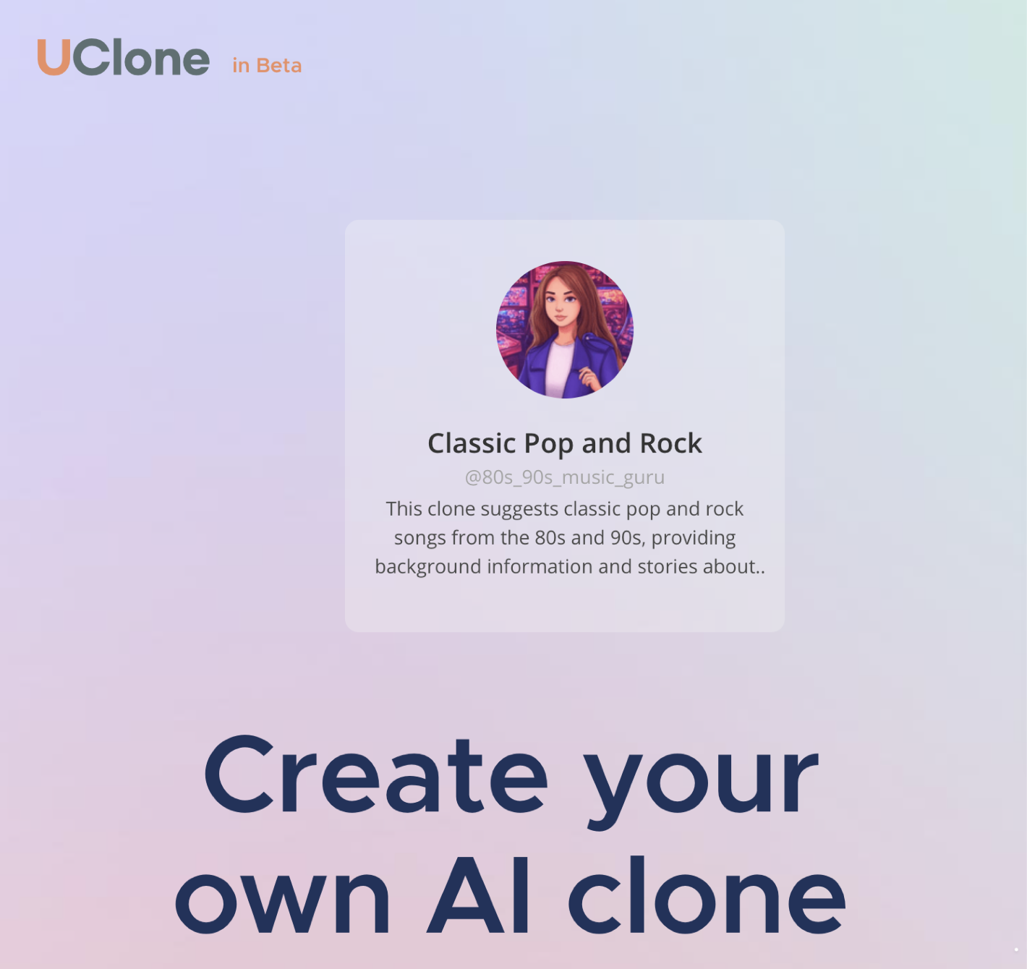

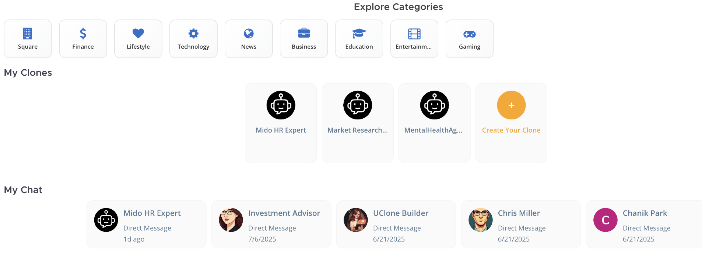
BOOST YOUR
DATA CENTER
www.mangoboost.io
www.uclone.net

